Slide 1
Mobile Applications Design
RESEARCH TEAM - MINSYST
Notes:
Gonzales

Slide 2

IT – 111 Team Members
Dimapilis, Joshua
Doniña, Thom
Elizondo, Kimberly
Hidalgo, Erika
Gapay, Gino
Gaoaen, Jestine
Gonzales, Nickolo
Notes:
Gonzales

Slide 3

Context
A research / a study for the design of Mobile Applications
Main Sections of the Application
Underlying Design Triggers
Design Process Actors
Actors and their Impact to the Design Process
Design Process Formation
Nature of their Influences
Design Process Implications
Methodology: Research and Analysis
Methodology for Verification: Survey Distribution

Slide 4

Discussion
Questions that the Research desires to answer:
Is design Market – driven or individual – driven?
Who are the actors in the design of Mobile apps?
How do these actors shape the design process?
What is the nature of their influence?
What are the implications in the design process?

Slide 5
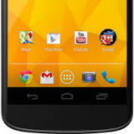
Data Gathering
RESEARCH AND ANALYSIS
Researching
Credibility Assessment
SURVEY ANALYSIS
Business – affiliated respondents
Designer respondents
METHODS:
Online Surveys
Paper Surveys
SUPPORT FOR FINDINGS
Respondents | # of Respondents
Business –affiliates (Online Survey) | 53
Business –affiliates (Paper Survey) | 26
Designers (Online Survey) | 39
Designers (Paper Survey) | 13
TOTAL | 131
Summary of Respondents

Slide 6

Scope and Limitations
Identify the answers to the 5 questions
Include only relevant responses
Use only data gathered through research
Use survey to support data gathered through research (or vice - versa)

Slide 7

Research Findings
RESEARCH TEAM - MINSYST
Notes:
Gapay

Slide 8

Underlying Design Triggers
DESIGN
In designing mobile apps, the preferences / professional opinion of the designer is taken into consideration, however the customer(target market, users)’s requirements still need to be taken into consideration (on Personalized UX) (Wondrack, 2015)
Researching for the application’s main purpose in the field, is also vital in designing the UI and UX of the product (Tyson, 2015)
Example: Lumosity and Neuroscience
Notes:
In designing mobile apps, the preferences / professional opinion of the designer is taken into consideration, however the customer(target market, users)’s requirements still need to be taken into consideration (on Personalized UX) - Dimapilis
Trends seen on the internet are considered by designers as factors for designing mobile applications - Gapay
For UI / UX designers, it is important to have an understanding of how the product feels for the user, and how it can create the best user experience - Doniña
Researching for the application’s main purpose in the field, is also vital in designing the UI and UX of the product - Dimapilis
Example: Lumosity and Neuroscience

Slide 9

Function and Trend
FUNCTION
There are certain features that the developer must consider in developing functionalities of a mobile application. (Gerber, 2012)
TREND
Mobile applications are now a part of companies digital strategies. (Anderson, 2015)
Incredible, world-changing software innovations often come from students. Mobile application competitors are mostly college students. (Castillo, 2015)
Notes:
Some points that developers believe must be considered in developing application features: - Elizondo
Keep it simple, prioritize speed, include analytics
Having user support is vital in mobile app development - Elizondo
People mostly use mobile apps rather than the web-based / website applications of the late, because of many reasons: - Gaoaen
Launching a mobile app is faster and more responsive than loading a mobile website;
Mobile apps can function offline and the web-based don't;
Mobile apps are easily downloaded in the Apps store;
Mobile apps enable push notifications for faster and effective way of reaching out to customer.

Slide 10
Mobile app design
Mobile App Design / Development Process, Grechanowski (2013)
Research and Business Discovery
Planning
Designing
Development
Testing
Launch / Deployment
Support and Optimization
Notes:
Some points that developers believe must be considered in developing application features: - Elizondo
Keep it simple, prioritize speed, include analytics
Having user support is vital in mobile app development - Elizondo
People mostly use mobile apps rather than the web-based / website applications of the late, because of many reasons: - Gaoaen
Launching a mobile app is faster and more responsive than loading a mobile website;
Mobile apps can function offline and the web-based don't;
Mobile apps are easily downloaded in the Apps store;
Mobile apps enable push notifications for faster and effective way of reaching out to customer.

Slide 11
Is design market – driven or individual -driven?
Researching for the application’s main purpose in the field, is also vital in designing the UI and UX of the product (Tyson, 2015)
*There is an inherent need for apps and the market demand can serve as market research for mobile app designers / developers

Slide 12
Is design market – driven or individual -driven?
*”There is a present ‘niche’, or a special space, in the market for Mobile apps that engage the users’ social and personal needs.”
*The most widely-used mobile app from the categories are Games and Social Networking Apps.

Slide 13
Results are leaning more on design being market-driven
*Inverse – parabolic curve, except for Work Communication apps and Business Related apps

Slide 14
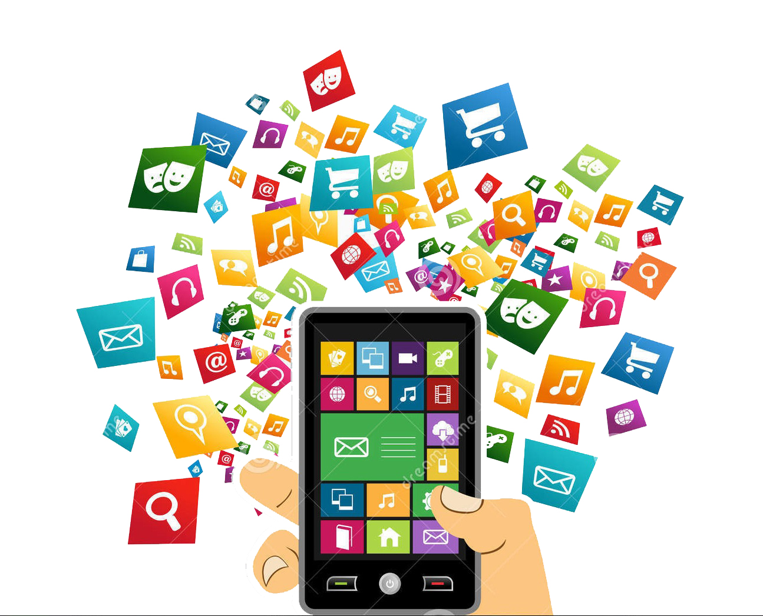
Design Process Actors
Sources of Influence
Cross checked the actors with 9 sources of influences (Millard, 2015)
Actors
Individuals or Personas that influence the Mobile app design process
Groups
Clusters of influential actors that affect Mobile app design
Elements
Intangible and abstract constructs that help form Mobile app design
Notes:
In designing mobile apps, the preferences / professional opinion of the designer is taken into consideration, however the customer(target market, users)’s requirements still need to be taken into consideration (on Personalized UX) - Dimapilis
Trends seen on the internet are considered by designers as factors for designing mobile applications - Gapay
For UI / UX designers, it is important to have an understanding of how the product feels for the user, and how it can create the best user experience - Doniña
Researching for the application’s main purpose in the field, is also vital in designing the UI and UX of the product - Dimapilis
Example: Lumosity and Neuroscience

Slide 15
Who are the actors in the design of the apps?
School requirements – Designer Students and Youth
Hobby / Interest – Adult and Professional Designers
*Professors, instructors and institutions (or schools) for the students’ Mobile app design process
*Hobbies / self – interests are in line with the latest trends that the respondent see, or with the respondents’ sphere of influence. (Millard, 2015)

Slide 16
Aside from institutions and their self, the client is also an important source of influence
*Client’s requirement -> Prioritized by designers (supports market – driven claim)
*Ergonomics and Practicality -> For the client, still dictates market – driven design

Slide 17
Actors and their Impact to the Design Process
Design Process Formation
Notes:
It is important to consider that some of those in the 7% answered “Depends on theme or concept of the team”, another response was “Depends on the nature of the project”, and another answered “Depending on the need of the client. I’m quite flexible with design so I can do any of both”.

Slide 18
How do these actors shape the design process?
*the latest trends in design involving the current tools or the technology used by most designers in the design process
“92% of the designers feel comfortable in consulting the UI / UX Community, in the form of Websites, Groups, Forums, articles and items of the like, (all present on the internet), in identifying and keeping up with the latest trends in design.”

Slide 19
Through nature of the project, theme / concept, trends, technology and tools
*availability of resources, tools and technologies, and those that are in demand
*From the answer of the respondents

Slide 20
Actors and their Impact to the Design Process
Nature of their Influence
What is the nature of their influence?
From the Survey: Profit, Job Opportunities, Hobbies / Interest, School Requirements
From the Responses: Theme, Concept of the Team, Nature of the Project and Need of the Client
From Research: Drive / Purpose of Competitions (Castillo, 2015) and (Anderson, 2015)
Notes:
It is important to consider that some of those in the 7% answered “Depends on theme or concept of the team”, another response was “Depends on the nature of the project”, and another answered “Depending on the need of the client. I’m quite flexible with design so I can do any of both”.

Slide 21

Design Process Implications
Integration of Mobile Apps in the industry of business – affiliates
Notes:
Interpretation of Results will be discussed by each team (1 Representative each)

Slide 22
Integration of Mobile apps in the industry, GDAP and IMMAP, Filipino Characteristics, trends, users’ benefit
Streetfood Tycoon
Pugo/BXtreme
TARA
Design is based on game’s objectives
Design is based on existing game
Design is based on functionality
Vendor-specific
Design is similar to y8 games
Follows the trend shared by media
Similarities:
These apps’ functions and designs are influenced by existing mobile apps on the app store, but these possess Filipino characteristics (eg. traits, media, solutions, etc.)
Somehow the trends that the developers’ / designer’s see in status quo, convince them to design / develop specific apps
Key-players decided to design these apps based on their ideals, but for their targeted users / clients
What is its implications in the design process?

Slide 23

Sources:
Dubois, D..(2014, October 21).The “Social Media New Deal” for Luxury Brands. Retrieved from http://knowledge.insead.edu/marketing-advertising/the-social-media-new-deal-for-luxury-brands-3649
Gerber, S. (2012, December 16). 13 must-have features for your next mobile app. Retrieved from http://thenextweb.com/entrepreneur/2012/12/16/13-must-have-features-for-your-business-mobile-app/
Mobile Applications in the building and construction industry. Retrieved from http://www.functionatl.com/media/support_images/Function_Mobile_Apps_Research.pdf
Mobile App 101: Key Functions to Consider.(2013, January 28). Retrieved from http://www.rainmaker-labs.com/mobile-app-key-functions/
UI, UX: Who Does What? A Designer's Guide To The Tech Industry. (2014, July 07). Retrieved from http://www.fastcodesign.com/3032719/ui-ux-who-does-what-a-designers-guide-to-the-tech-industry
Steve, C. .How to Design a Killer Mobile Ecommerce Website that will Boost Sales. Retrieved from http://mywifequitherjob.com/how-to-design-a-killer-mobile-ecommerce-website-that-will-boost-sales/
J, F. (2014, January 17). Lalaking naghahanap ng bulalo soup sa panaderya, nagwala nang bigyan ng cup noodles na bulalo flavor. Retrieved March 1, 2015, from http://www.gmanetwork.com/news/story/344328/ulatfilipino/balitangpinoy/lalaking-naghahanap-ng-bulalo-soup-sa-panaderya-nagwala-nang-bigyan-ng-cup-noodles-na-bulalo-flavorUI, UX: Who Does What? A Designer's Guide To The Tech Industry. (2014, July 07). Retrieved from http://www.fastcodesign.com/3032719/ui-ux-who-does-what-a-designers-guide-to-the-tech-industry
Wondrack, J..(2015, February 25). A Common Design Taxonomy. Retrieved from http://uxmag.com/articles/a-common-design-taxonomy

Slide 24
Sources:
Tyson, J..(2015, February 19).If You Build it (Right) They Will Come Lessons in successful consumer products from the DfE awards. Retrieved from http://uxmag.com/articles/if-you-build-it-right-they-will-come
Tan, A. (2015, February 9). How to Choose the Best Platform for Your Mobile App? Retrieved March 1, 2015, from https://www.smaato.com/how-to-choose-the-best-platform-for-your-mobile-app/
Luces, K/JDS. GMA News. Pinoy Flappy Bird-inspired game Pugo is top pick on AppStore Retrieved from http://www.gmanetwork.com/news/story/350722/scitech/geeksandgaming/pinoy-flappy-bird-inspired-game-pugo-is-top-pick-on-appstore/
Imagine Cup 2014 Winners. (2014). Retrieved from https://www.imaginecup.com/Custom/Index/2014Winners_Finals
Castillo, W. (2015, January 30). Voices: Do companies take college student app developers seriously?. Retrieved from http://college.usatoday.com/2015/01/30/voices-do-companies-take-college-student-web-developers-seriously/
Anderson, T.(2015, February 16).What does the rise of digital marketing mean for luxury brands?. Retrieved from http://www.theguardian.com/marketing-luxury-goods-feb-15/2015/feb/16/digital-marketing-luxury-brands
Fadeyev, D..(2008, December 15). 10 Useful Techniques To Improve Your User Interface Designs. Retrieved from http://www.smashingmagazine.com/2008/12/15/10-useful-techniques-to-improve-your-user-interface-designs/
Kuyimobile (n.d.). Retrieved April 12, 2015, from http://www.kuyimobile.com/
Day, G. (1998). What Does it Mean to be Market-Driven? Retrieved April 11, 2015, from http://www.walsh.edu/uploads/BUS416Week4WhatDoesitMeantobeMarketDriven-11464.pdf
Notes:
Conclusion – Dimapilis
Closing - Everyone

Slide 25
Sources:
Warren, C. (2010, July 7). 5 Things to Consider When Designing Your Mobile App. Retrieved April 11, 2015, from http://mashable.com/2010/07/07/designing-mobile-apps/
Tan, A. (2015, February 9). How to Choose the Best Platform for Your Mobile App? Retrieved March 1, 2015, from https://www.smaato.com/how-to-choose-the-best-platform-for-your-mobile-app/
Pearson, D. (2014, October 22). Report: Mobile to become gaming's biggest market by 2015. Retrieved April 11, 2015, from http://www.gamesindustry.biz/articles/2014-10-22-report-mobile-to-become-gamings-biggest-market-by-2015
Morrison, C. (2014, November 10). Why You Shouldn’t Hire a UI/UX Designer. Retrieved April 12, 2015, from http://www.usertesting.com/blog/2014/11/10/dont-hire-ui-ux-designer/
Game Developers Association of the Philippines | We make games that rock! (n.d.). Retrieved April 12, 2015, from http://www.gdap.org.ph/
DLSU, Nokia stage inter-school mobile app dev't contest. (2012, February 2). Retrieved April 12, 2015, from http://newsbytes.ph/2012/02/02/dlsu-nokia-stage-inter-school-mobile-app-devt-contest/
UP coders win Accenture app-development competition. (2014, February 8). Retrieved April 12, 2015, from http://www.gmanetwork.com/news/story/347605/ scitech/technology/up-coders-win-accenture-app-development-competition
Caritakathon 2014. (n.d.). Retrieved April 12, 2015, from http://www.pwdo.org/hackathon/
Philippine Commission on Women. (n.d.). Retrieved April 12, 2015, from http://www.pcw.gov.ph/event/magna-carta-women-mobile-apps-development-contest
Developers Connect Philippines | Frequently Asked Questions. (n.d.). Retrieved April 12, 2015, from http://devcon.ph/about
Thank you
Notes:
Conclusion – Dimapilis
Closing - Everyone

